Slide 1
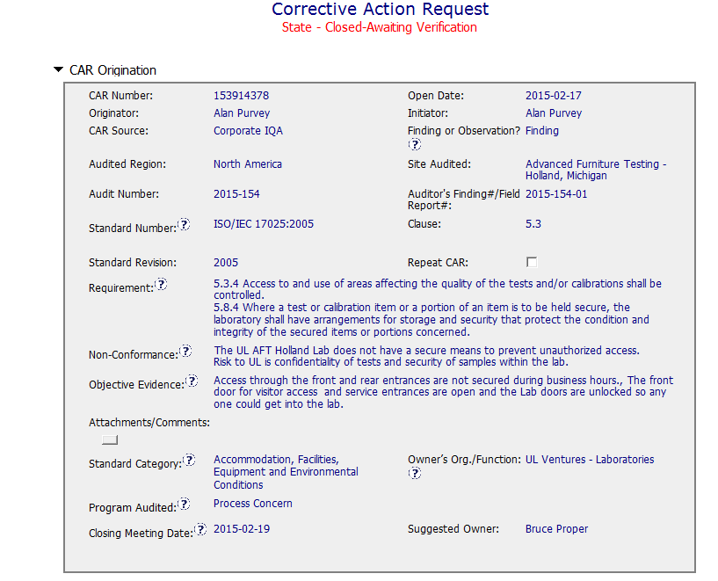
CAR 153914378 - EXEMPLARY
All fields completed appropriately

Slide 2
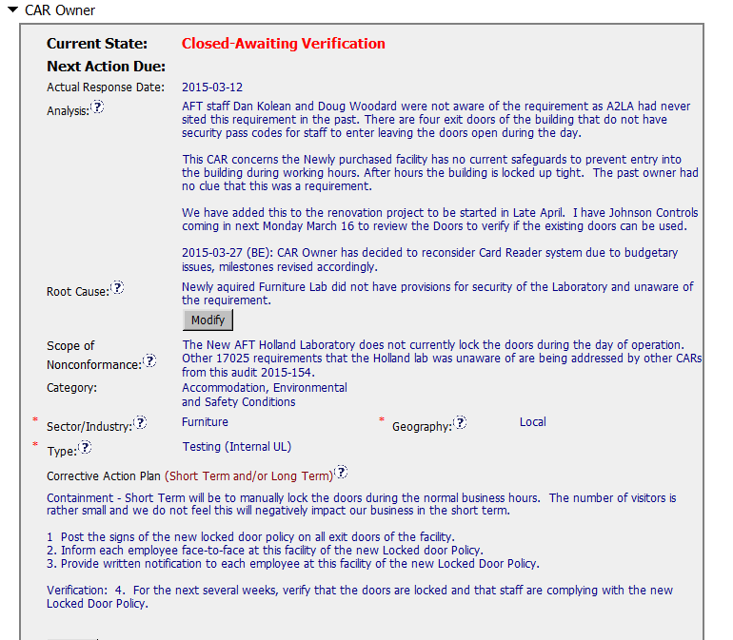
CAR 153914378 - EXEMPLARY
Analysis provide a good approach to the real reasons of the problem detected
Stakeholders involved in the analysis.
Containment stop the bleeding!!!

Slide 3
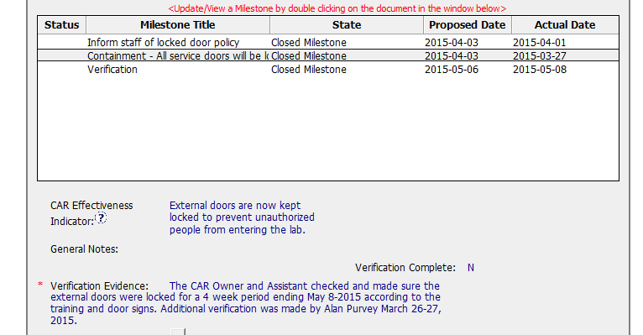
CAR 153914378 - EXEMPLARY
Milestone plan is aligned with the CA Plan proposed
Verification evidence for closure is appropriate

Slide 4



CAR 153914378 - EXEMPLARY
INTEGRITY
Initiative & Decision Making Analyzing & Problem Solving | Facilitates progression of the CAR through closure: extensions, escalations, reassignments, etc. Accurately completes the administrative fields within the CAR such as root cause category, process impacted, geography, etc. Acts on CARs within the required timeframe Facilitates the handling of disputed CARs (C) Extensions are within requirement (<30 days, 3 or less) (T) Most appropriate ‘category’, ‘type’, ‘geography’ are selected (P) Facilitates the handling of disputed CARs (T) Acts on CARs within required timeframe
COMPETITIVENESS
Customer Focus Achieve Business Results Flexibility | Assists customers as they address all aspects of the CAR – analysis, root cause statement, milestone, containment, verification, etc. Verifies CARs timely (C) Analysis shows clear path to root cause and scope; stakeholders identified (C) Root cause statement is succinct, reasonable, complete (Shows ‘N/A’ for observations) (C) Corrective actions fix the objective evidence and other problems found; address entire root cause and scope. For observations, they do not go beyond fixing the objective evidence (C) Milestones address containment & owner’s verification; completed per milestone expectations (P) Verification per requirements
COLLABORATION
Leading & Engaging Teamwork Communication | Provides pertinent feedback at appropriate times; shares information and keeps others informed Supports other CAR Champions by serving as their backup when they are absent Works as a team player with other CAR Champions (L) Referenced communications are attached as needed (C L) Evidence of communication for overdue/escalated CARs and other pertinent concerns (P) Trains other CAR Champions
CL

